Slide 1
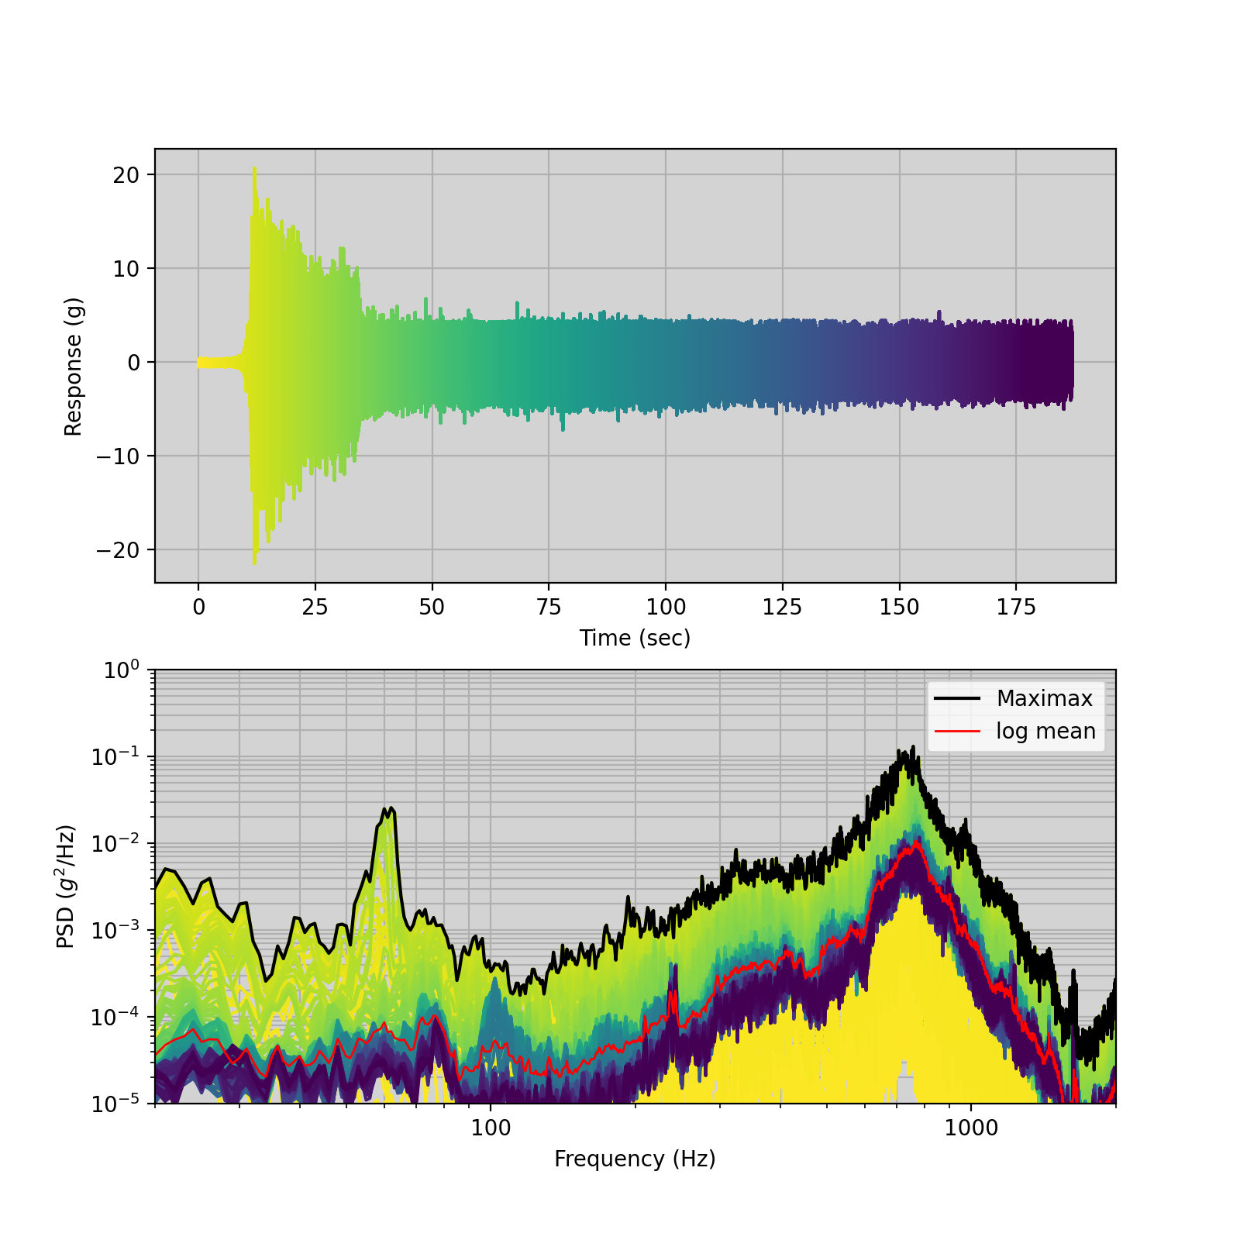
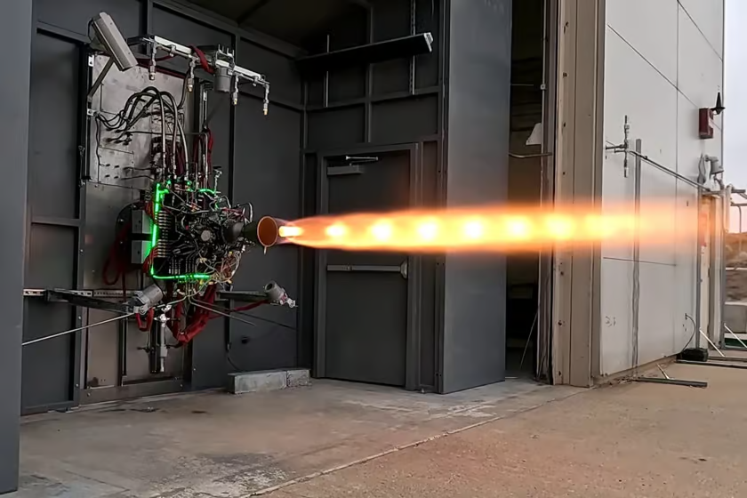
Data is per aircraft takeoff example
https://endaq.com/pages/free-vibration-analysis-files
Pre-Test
Process Engine Data
Analysis done using dynamight
Primary Challenge:
Engine hotfires need to be processed regularly
10+ total engines, many tests, 100k Hz
Many accelerometers (Typically ~15 axes per engine)
Verify in family; verify past results in family
Very manual process and many other things to do
Requirement: Setup process and give to new grads to run as tests come in
Secondary Req: Predict component responses in other locations on vehicle and verify appropriately margined
https://newatlas.com/military/ursa-major-hypersonic-engine-hotfire-tests/

Slide 2
Pre-Test
Quick Look
Step 1: Look at baseline engine data
Mean is biased by non-data; large transient
Need to deal with transients
Start by removing pre-test

Slide 3
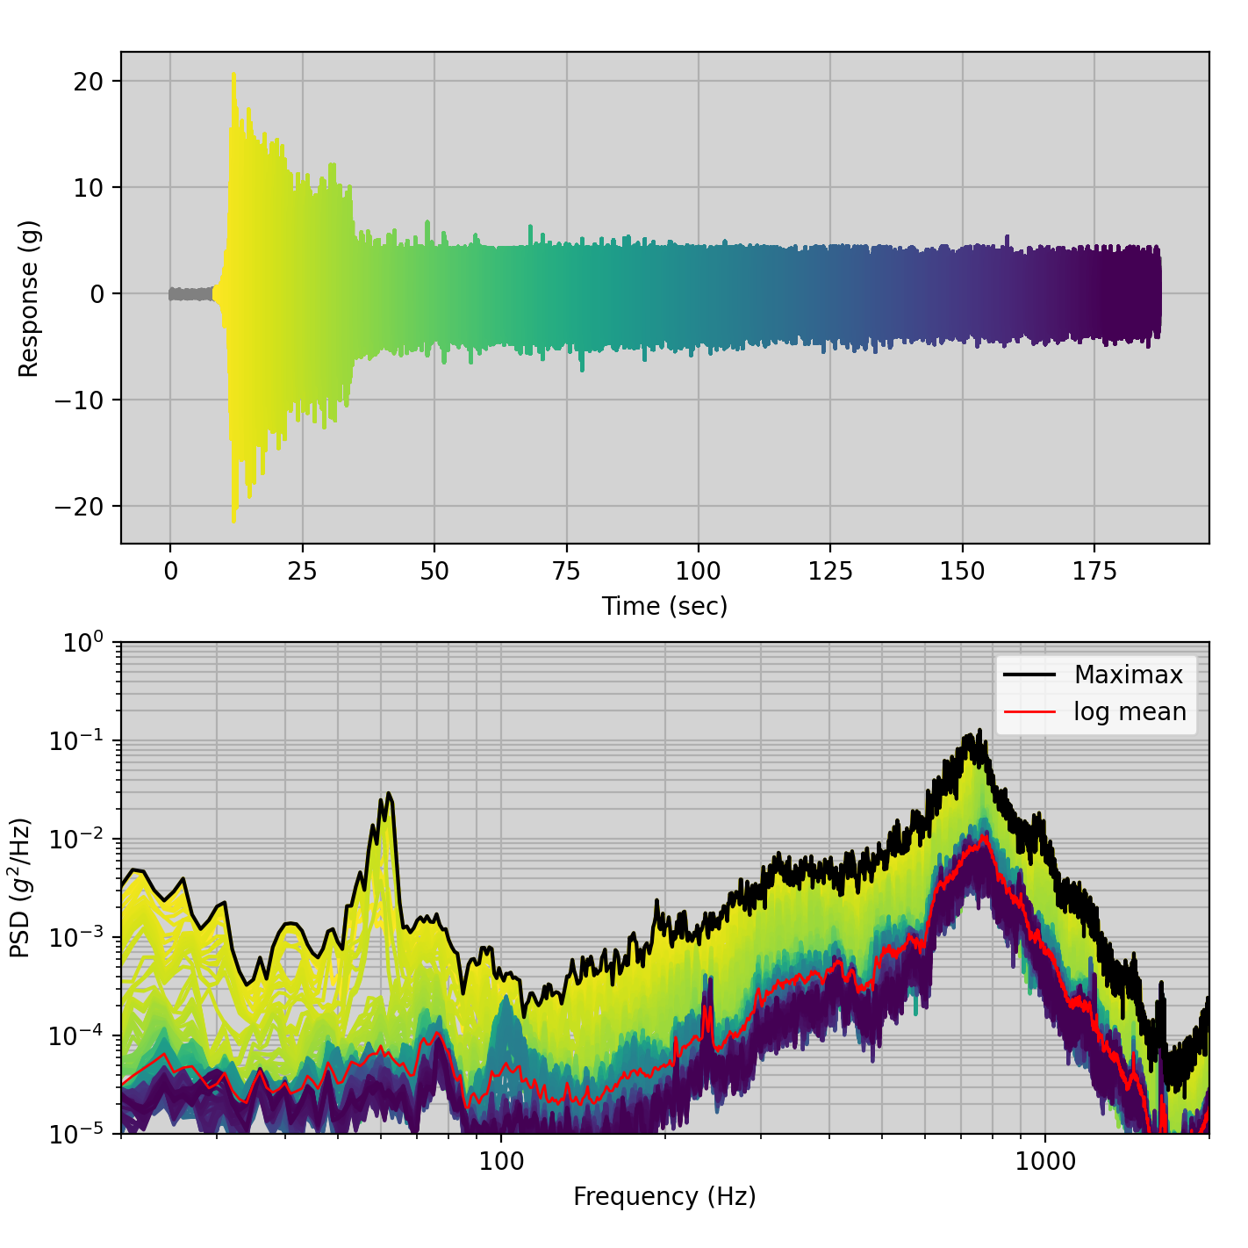
Remove Pre-Test
Takeoff transient is 28s / 188s = 15%
Engine transient is 3-5s / 180s = 2-3%
Shock event processing not addressed here
Log Mean barely changed

Slide 4
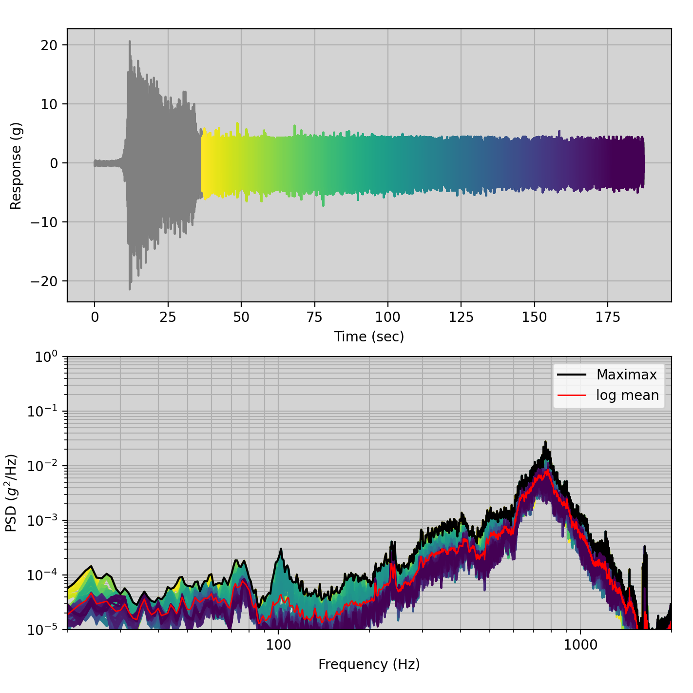
Remove Transient
Core signal is largely ergodic and stationary
Ideal signal
No filtering required
Log Mean is 50/50 (unmargined) ASD curve
Log Mean

Slide 5
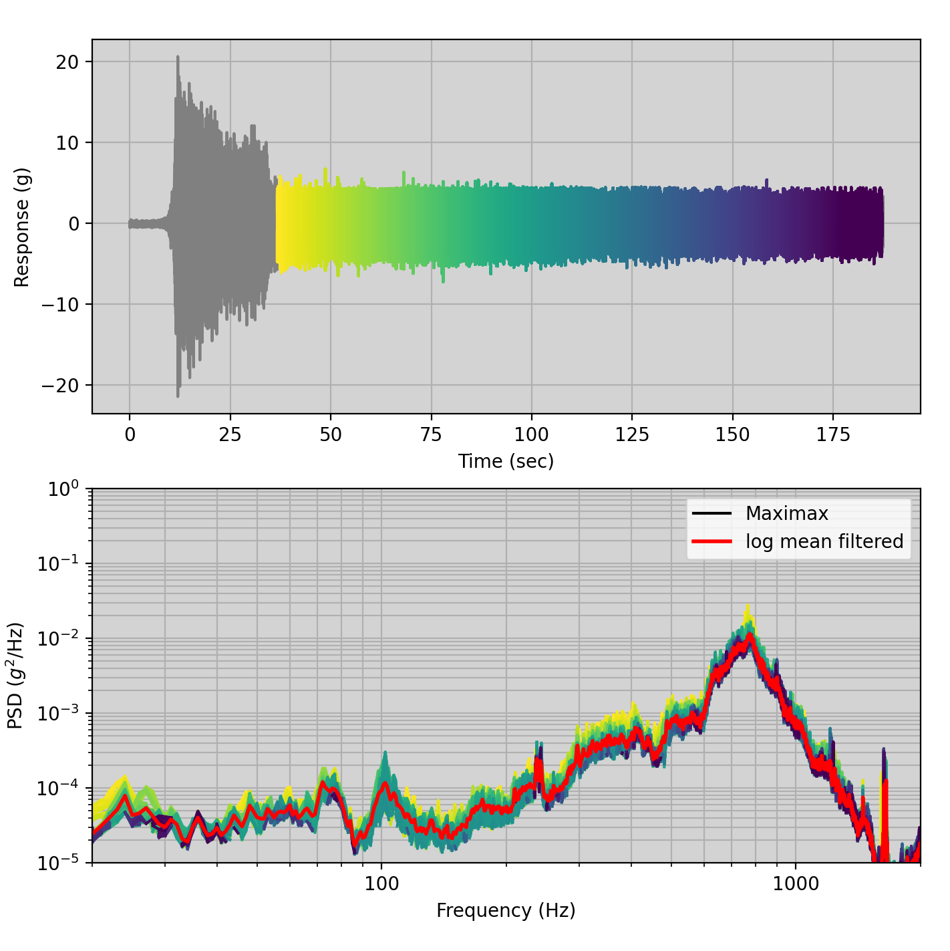
Filter Low Data and Reprocess
Calculate Log Mean as previously on whole signal
Filter data below Log Mean (set to NaN)
Calculate Log Mean based on new data (log mean filtered)
Slightly conservative if you remove pre-test

Slide 6
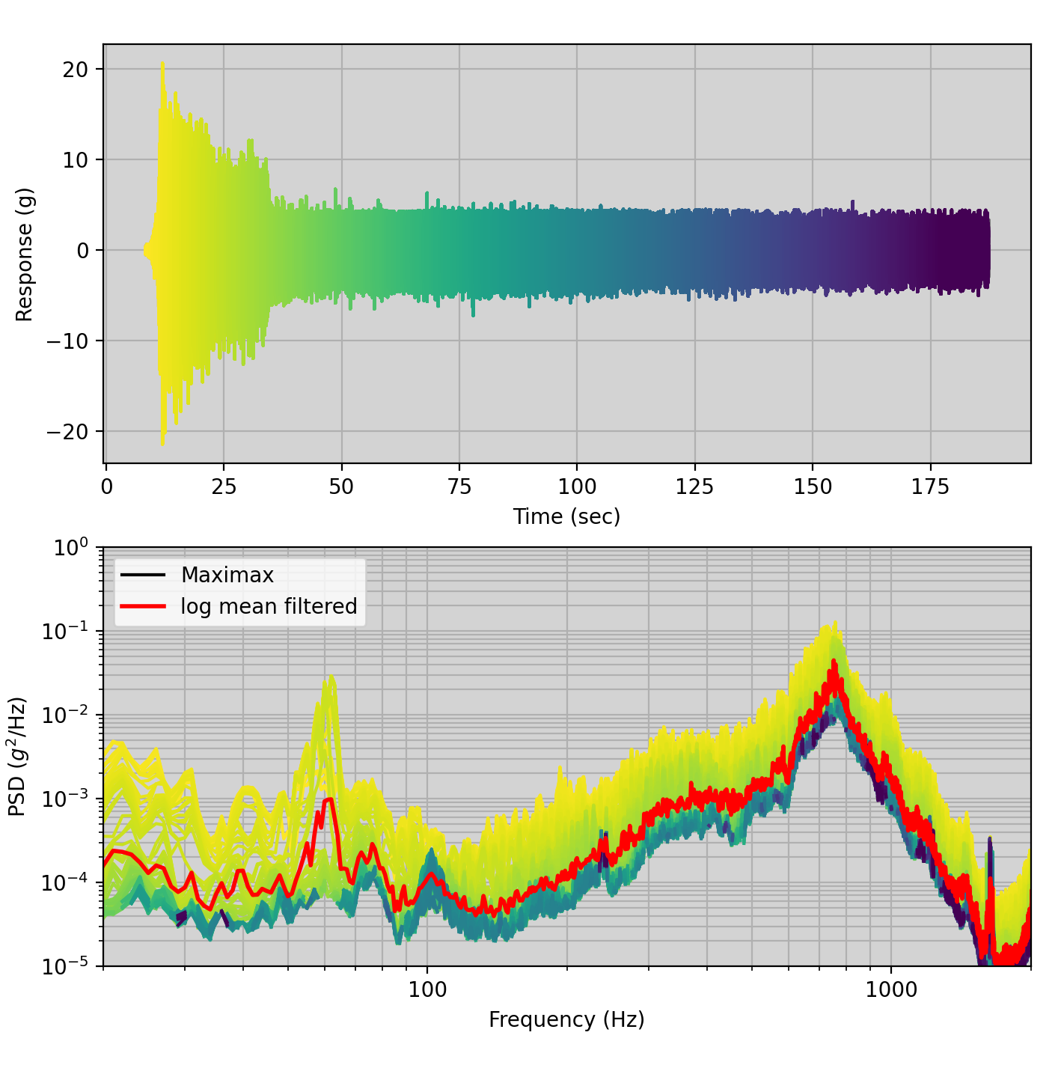
Do it Faster
Repeat process but with same full data set
Slightly conservative, but in the noise
Actual transient was ~1/5th as long
Repeat for entire family bounding to get P50/50
Run SEA analysis (didn’t do this step)
Lesson Learned:
Not having established process & tools made large datasets difficult to process
Simple tools go a long way
Being slightly conservative lets you quickly identify issues

Slide 7
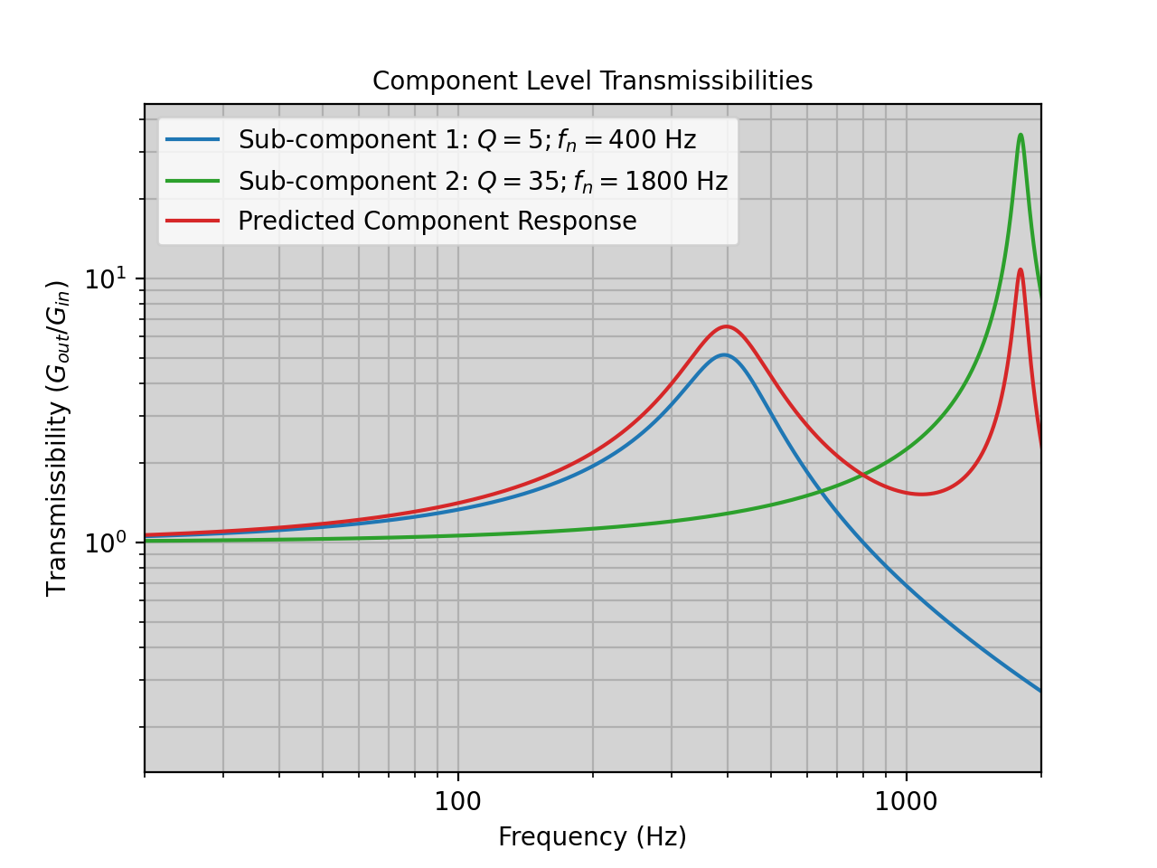
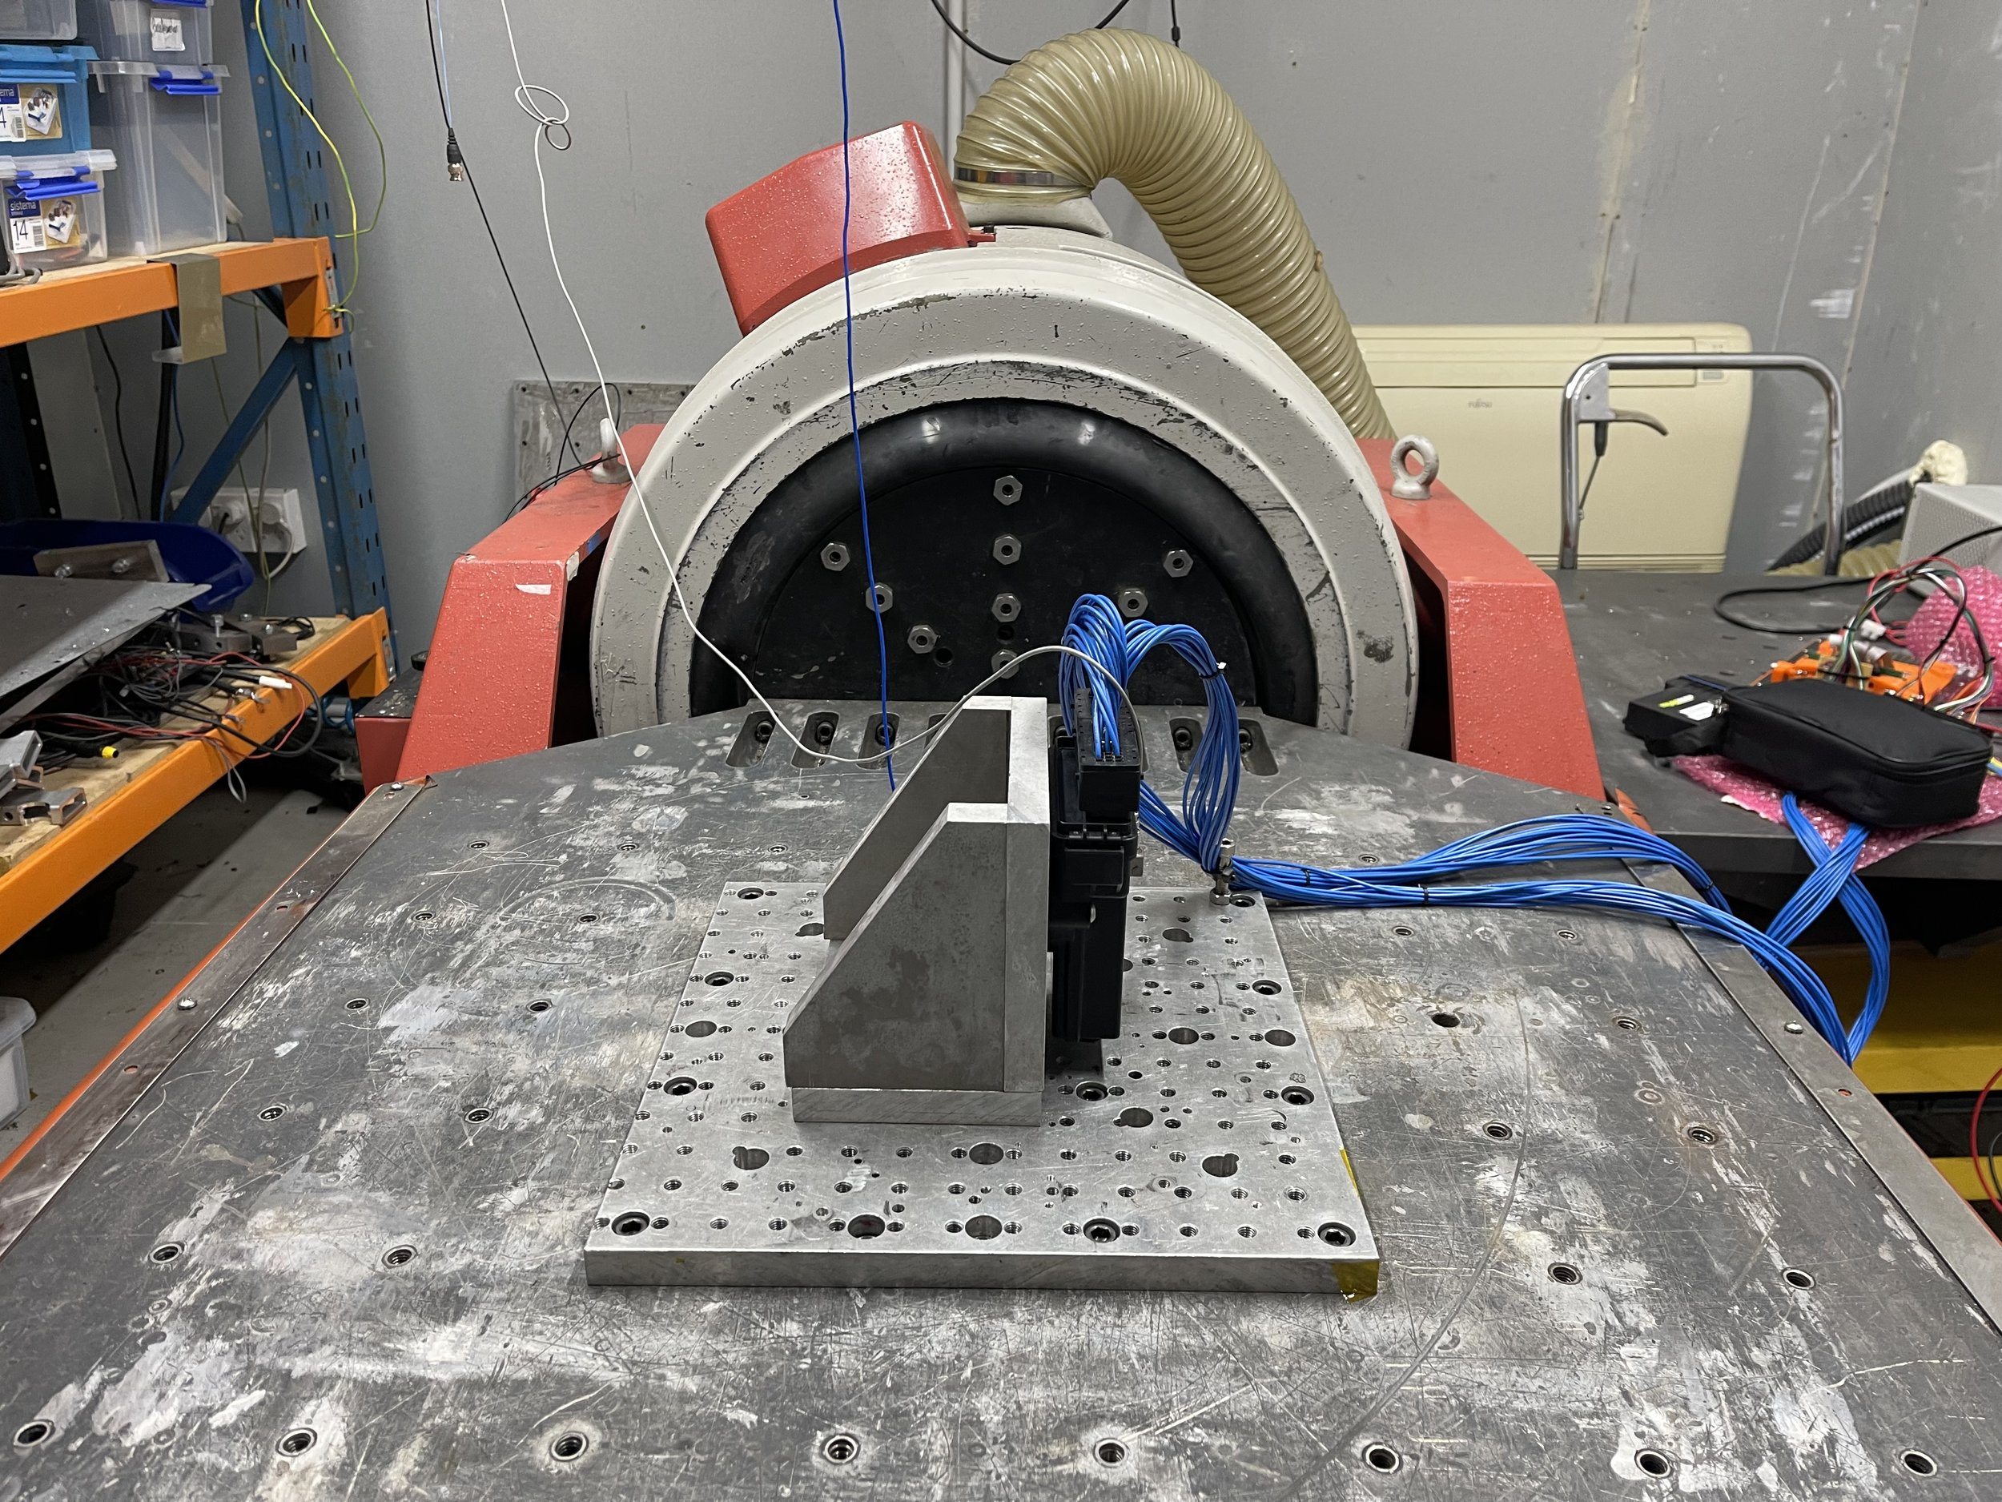
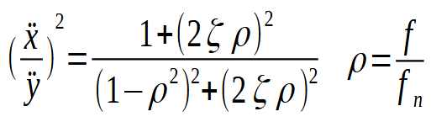
Component level Prediction/Testing
Convolve sub-components responses using Lab Data
Time Domain Convolution is Freq Domain Multiplication
https://www.halthass.co.nz/lab-services/vibration-and-shock-testing

Slide 8
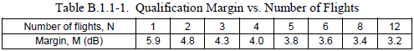
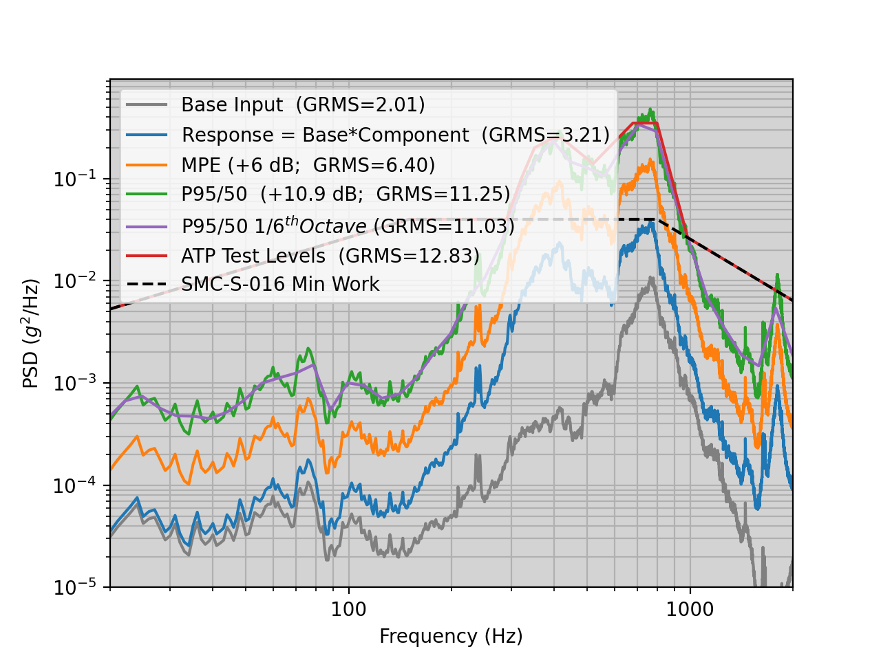
Final Predictions & Modification
https://explorers.larc.nasa.gov/2019APSMEX/MO/pdf_files/SMC-S-016_05SEP2014.pdf
Convolve Signals
Acceptance test performed at P95/50
Add 4.9 dB to go from P50/50 to P95/50
Add 5.9 dB uncertainty for first flight (Table B.1.1-1)
Additional mode characterized
Strong impact on FTS electrical component
2x decrease in PSD amplitude would correct issue (minimal damping)
Very localized mode (shifting mode would fix problem)
Loosely tightened grommets fixed issue (not for flight)
Proposed low profile damper config change
Lessons Learned: Breaking down components and running individual sine sweeps allows you to understand what you’re seeing during random vibe
Critical Mode

